Slide 1

SnapTutor – Paper Prototype Presentation
Carlon Bullock
The University of Arizona Global Campus
INT305: Mobile Application Design & Development
Professor: John Russell
March 17th, 2025

Slide 2

Introduction / App Overview
Brief description of SnapTutor: An AI-powered educational app designed to scan text, generate explanations, quizzes, and translations for learning enhancement.
Purpose of the prototype: This prototype demonstrates SnapTutor’s core user flow, designed with accessibility and intuitive navigation in mind.
Notes:
SnapTutor is designed as an AI-powered educational app that allows users to scan printed or handwritten text and convert it into interactive learning materials. The app offers three core functions: providing simplified explanations, generating quizzes, and translating content. This prototype demonstrates the key user flow, focusing on accessibility, ease of use, and alignment with mobile design principles explored throughout this course.

Slide 3

User Flow Summary / App Process
User launches SnapTutor from their iPhone home screen.
Home screen displays a “Scan Text” button prompting the user to start.
User captures printed or handwritten text using the in-app camera interface.
AI processes the scanned text and presents three learning paths:
View Simplified Explanation
Generate Quiz
Translate Content
User selects a learning path based on their needs.
If the Quiz feature is chosen, the user interacts with auto-generated multiple-choice questions.
Answers are clickable, allowing for smooth, instant interaction.
Notes:
This slide provides a summary of SnapTutor’s user flow. The user begins by launching the app and selecting the scan text option. After capturing the content, SnapTutor’s AI processes the scan and offers three distinct pathways. Users can either view a simplified explanation, generate a quiz, or translate the content. If the quiz option is selected, users engage directly with AI-generated multiple-choice questions. This flow is designed to ensure a minimal learning curve while supporting various educational needs.

Slide 4
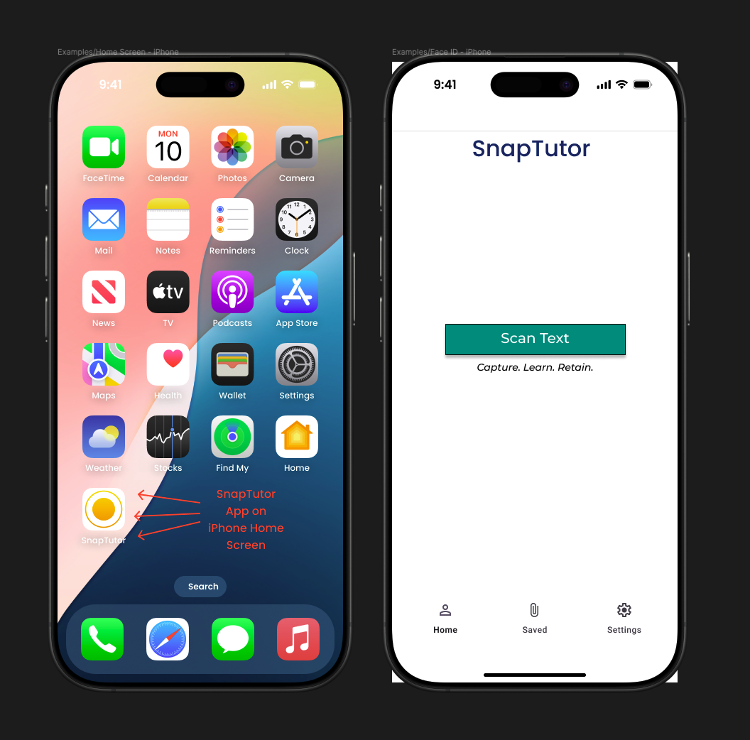
Screen 1 — Home Screen
Notes:
This is the SnapTutor home screen. The interface is intentionally minimal, guiding users toward the primary action—scanning text. The bottom navigation bar allows quick access to saved content and settings. The call-to-action button is placed centrally, ensuring users understand the app’s purpose upon first launch.

Slide 5
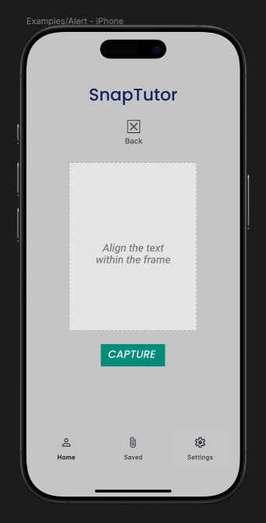
Screen 2 — Text Capture
Notes:
Here, the user is directed to the text capture screen. A camera frame provides guidance on where to align the text for optimal scanning. The large capture button reinforces the app’s simplicity by offering a single action. This design ensures the scanning process is intuitive and accessible, even for first-time users.

Slide 6
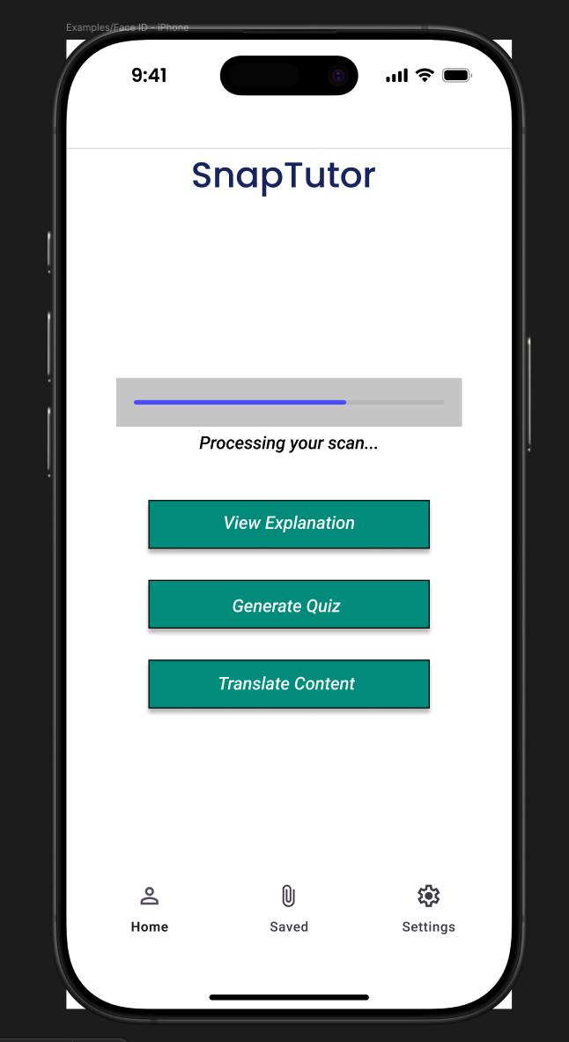
Screen 3 — AI Processing & Options
Notes:
After capturing the text, SnapTutor’s AI processes the scan. A progress indicator is displayed for user feedback. Once processing is complete, the user is presented with three options—view an explanation, generate a quiz, or translate the content. These options are core to the app’s educational functionality and are designed to be easily selectable.

Slide 7
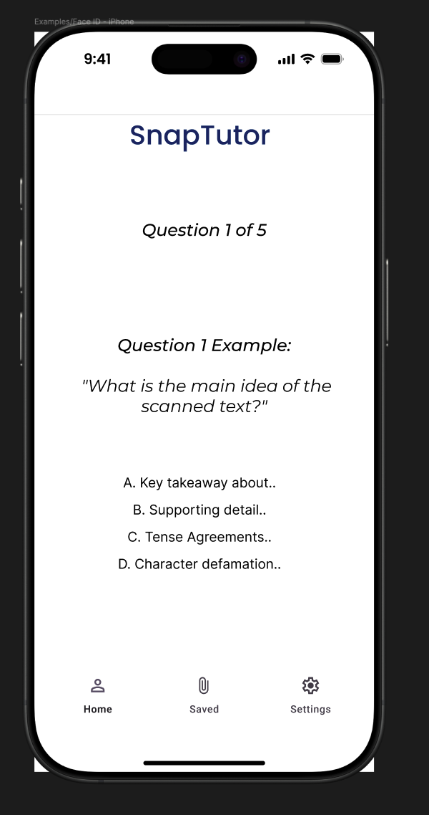
Screen 4 — Interactive Quiz
Notes:
This is the AI-generated quiz screen. The user is presented with a multiple-choice question derived from the scanned content. For this prototype, clickable answer options replace a traditional submit button to streamline interaction. This design choice reduces friction and supports faster engagement while maintaining usability.

Slide 8

Prototype Review
Reviewed user flow and visual clarity
Confirmed navigation consistency between screens
Simulated AI text-to-quiz behavior
Validated layout simplicity for first-time users
Notes:
While SnapTutor is still a prototype, informal testing focused on clarity and consistency. I reviewed each screen’s navigation logic and ensured that the transition from scanning to quiz generation made sense from the user’s perspective. The mock-up was tested to simulate expected behaviors such as AI responses and translations, reinforcing the app’s practical intent.

Slide 9

Feedback & Improvements
Simplified home screen navigation
Removed redundant buttons for clarity
Improved spacing and color contrast
Added visual logic placeholders based on peer suggestion
Notes:
Throughout the course, peer and instructor feedback was invaluable. I responded by simplifying the home screen and making button placement more intuitive. I also made visual adjustments like spacing and contrast for improved accessibility. Finally, I added a logic placeholder file to represent backend logic more clearly.

Slide 10

Technical Considerations
Fragments: Modular UI for scanning, quizzes, settings
Data Handling: Potential for cloud-based storage
Background Tasks: AI processing and translation in real-time
Notes:
If SnapTutor were developed, it would benefit from fragments to keep the UI modular and responsive. Data handling would scale better through cloud storage so users can save progress. Background tasks could allow for real-time translation and explanation processing while keeping the UI smooth and uninterrupted.

Slide 11

Next Steps for SnapTutor
Add progress tracking and visual reports
Introduce study reminders and AI feedback
Expand translation library and accessibility options
Notes:
Looking forward, SnapTutor could incorporate user progress tracking, voice-based interaction, and expanded translation libraries. Adding reminders and personalized learning feedback could turn this into a more adaptive tool for students.

Slide 12
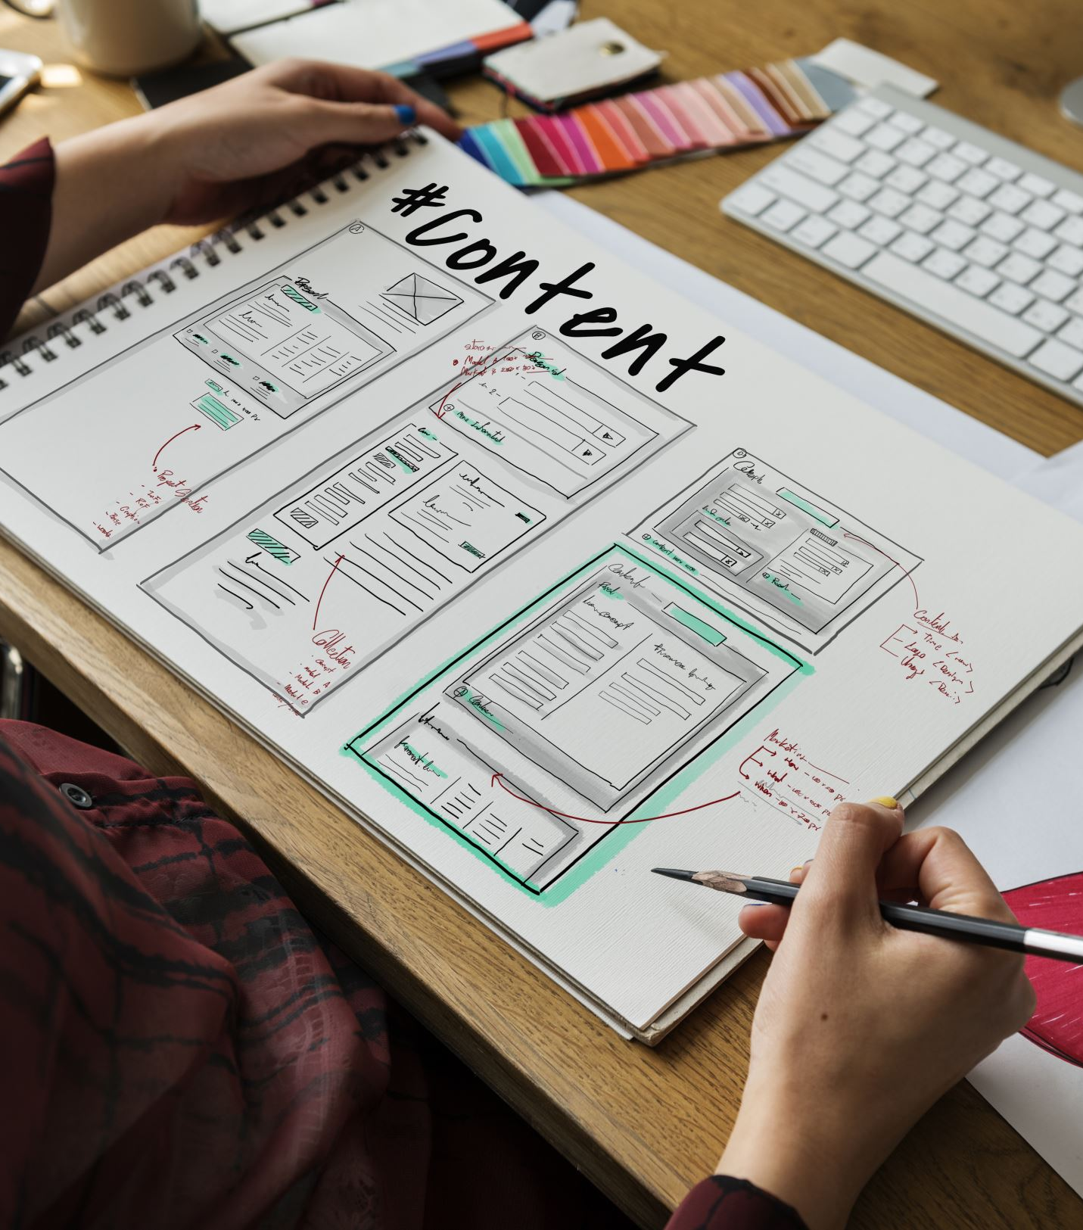
Why SnapTutor Works
Fills mobile learning gap with real-time tools
Minimalist design supports usability
Scalable feature set for long-term engagement
Built for students, designed to evolve
Notes:
SnapTutor is designed to simplify learning, not complicate it. It focuses on visual clarity, actionable tools, and smooth navigation. The app structure supports expansion, while its current features already address key educational challenges. Thank you for considering SnapTutor as a smart, scalable solution for modern learners.

Slide 13

Conclusion
SnapTutor prototype demonstrates a clear and accessible user flow.
Focuses on AI-driven learning tools designed for educational engagement.
Prioritizes minimal design to reduce cognitive load and enhance usability.
Features support interactive learning through explanations, quizzes, and translations.
Future development will include digital prototyping, user testing, and feature refinement.
Notes:
In summary, this prototype phase demonstrates SnapTutor’s core user experience, focusing on clean design and intuitive navigation. Future iterations will focus on digital prototyping, user testing, and refining features based on feedback.

